Slide 1

SoftEDA: Rethinking Rule-Based Data Augmentation with Soft Labels
Juhwan Choi, Kyohoon Jin, Junho Lee, Sangmin Song, Youngbin Kim*
Juhwan Choi gold5230@cau.ac.kr
Notes:
Good morning, everyone. It is my great pleasure to meet you at this session. My name is Juhwan Choi and I will be presenting our research paper titled "SoftEDA: Rethinking Rule-Based Data Augmentation with Soft Labels” today. In this paper, we proposed novel, yet simple method for improving existing rule-based text data augmentation methods.

Slide 2
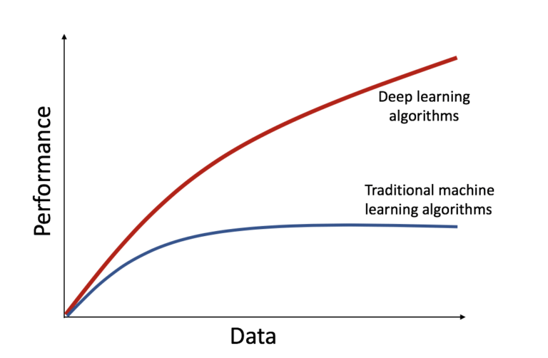
Intro: Importance of Data
Deep Learning is data-hungry strategy
Image from https://abyssal.eu/were-data-hungry/
Notes:
As we all know, the performance of deep learning is hardly affected by the amount of data.

Slide 3
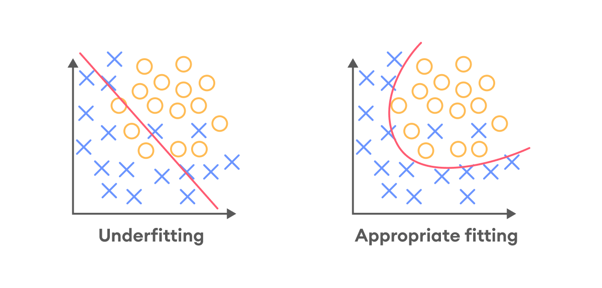
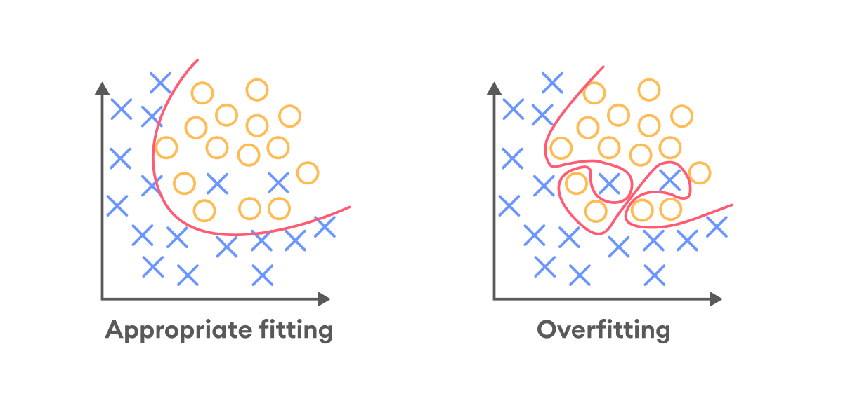
Intro: Importance of Data
Insufficient data may lead to overfitting
Image from https://medium.com/@hassankashi.official/deep-learning-convolutional-neural-networks-cnn-recurrent-neural-networks-rnn-lstm-long-7ba53032b46c
Notes:
If we do not have enough amount of data for training the deep learning model, it may suffer from the “overfitting” problem.
The overfitting phenomenon leads to lack of generalizability, which means the model is useless for real-world application.

Slide 4
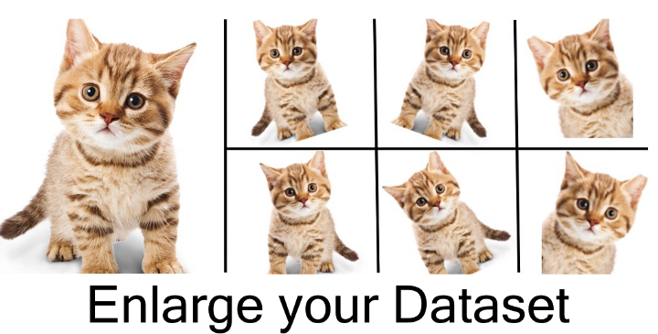
Intro: Data Augmentation
A common approach to mitigate overfitting
Image from https://wikidocs.net/166068
Notes:
Data augmentation is a common strategy to alleviate this overfitting problem. The purpose of data augmentation is to modify the current dataset, and get slightly different one. By using this augmented data for training in addition to original training data, we can enhance the performance and generalizability of the model.

Slide 5
Intro: Difficulty of Text Data Augmentation
Augmentation
Preserving
Semantics
Flipping
Rotating
Cutout
Semantics
Changed
This is a cat
Augmentation
Is this a cat
Notes:
To augment image data, we can apply simple manipulations such as horizontal flipping, slightly rotating the given image, or masking small region of the image.
These modification techniques are called rule-based data augmentation, and the point is, the important information that this image is a photo of cat is still preserved after applying such a rule-based method.
Thus, rule-based augmentation methods are widely used for computer vision domain.
However, to augment text data, we should consider their characteristic.
If we try to augment the sentence “This is a cat” by swapping the order of words, the augmented sentence “Is this a cat” has a totally different meaning from original sentence.
This characteristic of text data makes rule-based augmentation methods less helpful.
However, rule-based augmentation methods are still worth to investigate because of its simplicity.

Slide 6
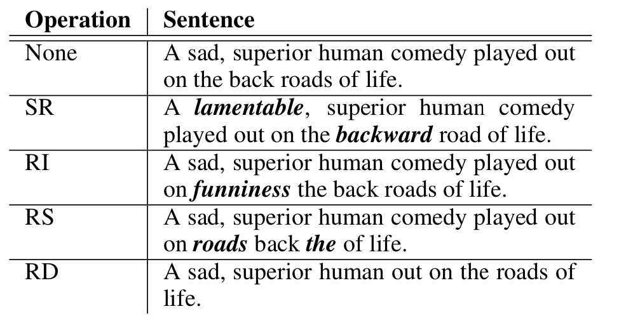
Intro: Previous Text Augmentation – EDA
Make random word-level changes
EDA: Easy Data Augmentation Techniques for Boosting Performance on Text Classification Tasks
Wei et al., EMNLP 2019
Notes:
Okay, now we will introduce previously suggested text data augmentation methods.
EDA, Easy Data Augmentation is well-known rule-based text data augmentation strategy and the direct predecessor of this work.
It consists of four different sub-operations.
The first one is Synonym Replacement, which randomly selects few words and changes them into their synonyms.
Second, Random Insertion is conducted by inserting some random words to given sentence.
Third one, Random Swap is an operation that swaps the order of words in the sentence.
Lastly, Random Deletion performs a deletion of some random words from the sentence.
EDA randomly selects and applies one of these sub-operations to given sentence and generate augmented sentence.

Slide 7
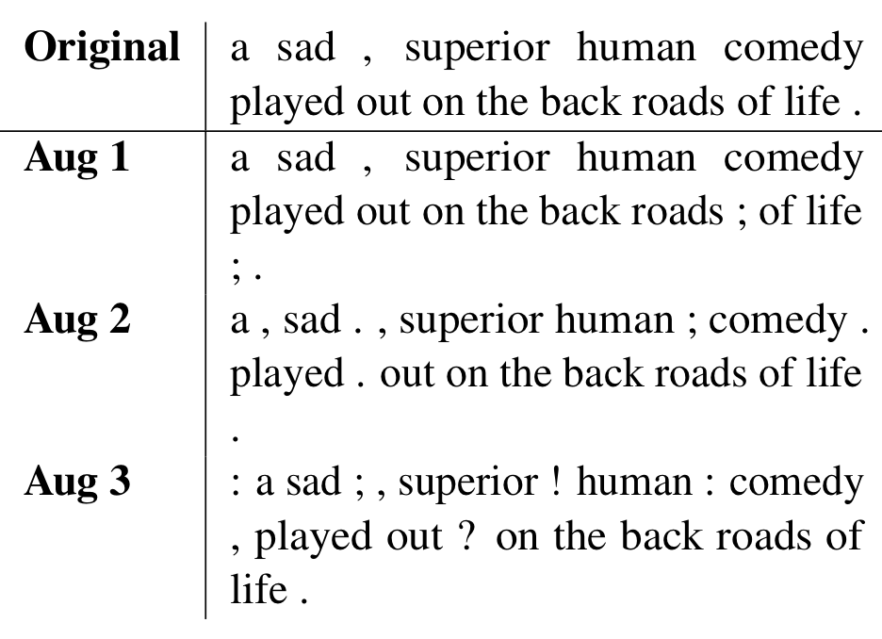
Intro: Previous Text Augmentation – AEDA
Random insertion of punctuation marks
AEDA: An Easier Data Augmentation Technique for Text Classification
Karimi et al., Findings of EMNLP 2021
Notes:
AEDA is a variant of EDA. This method is solely based on the random insertion operation mentioned in the previous slide, and it inserts punctuation marks to given sentence.
Authors of this paper argued that the original semantic is preserved as it maintains all the words of original sentence and its word order.
However, this method has less variability of generated sentence compared to EDA.

Slide 8
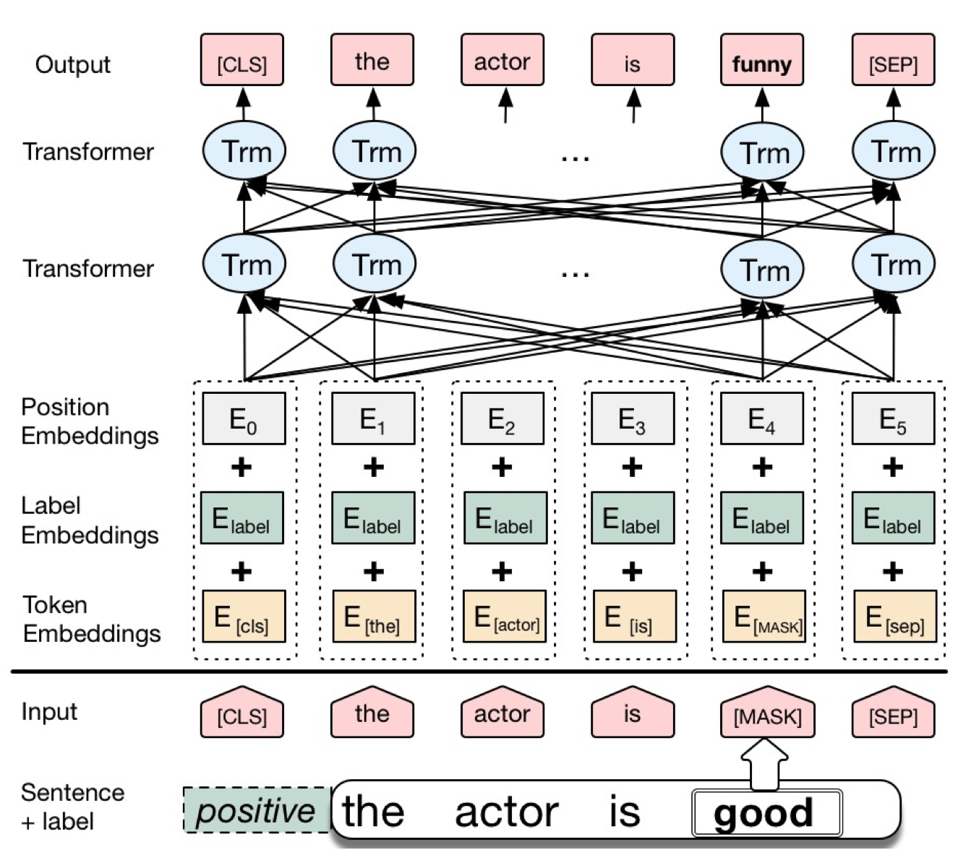
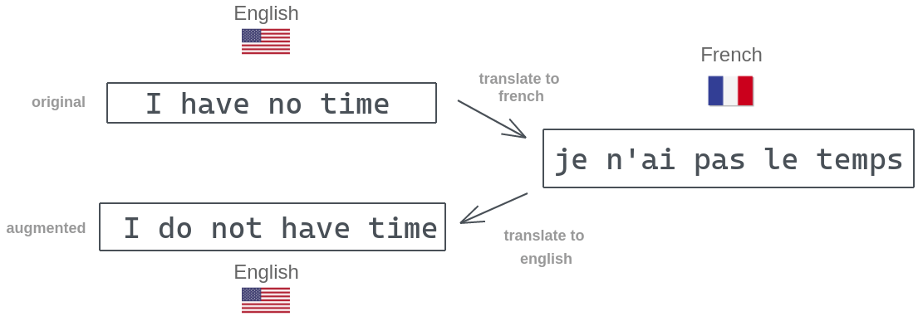
Intro: Previous Text Augmentation – Others
Back-Translation
Sennrich et al.
Conditional BERT
Wu et al.
Image from https://amitness.com/2020/02/back-translation-in-google-sheets/
Notes:
There are other methods that uses deep learning model to augment given data instead of applying such a simple rules.
One important strategy is Back-Translation, which translates a sentence to another language first, and then translates it back to original language.
Another methods, such as Conditional BERT, utilizes the ability of pre-trained language models to synthesize a sentence and change the word of it considering its context.
However, these methods are more complex than rule-based ones and it costs to employ neural networks to augment data.

Slide 9
Our Intuition
How can we improve existing rule-based methods while maintaining its simplicity?
Notes:
So, our purpose of this research was to enhance existing rule-based augmentation methods, since they are useful in the real-world application.
We aimed to improve rule-based methods while maintaining its simplicity, as it is the most important benefit of rule-based methods.

Slide 10
Our Intuition
Rule-based text augmentation methods
make perturbed data
Is it okay to assign ground-truth label to such data?
Augmented data should have less certain label
Notes:
As we have seen before, rule-based text data augmentation methods generate a perturbed data through simple operations.
And our main intuition is, that these kind of noisy data should have less certain label compared to one-hot label of original data.
In most of data augmentation techniques, the augmented data has exact same label value with the original data.
However, this may be inappropriate to perturbed, and uncertain data compared to original data.
To solve this issue, we assigned soft label to augmented data.

Slide 11
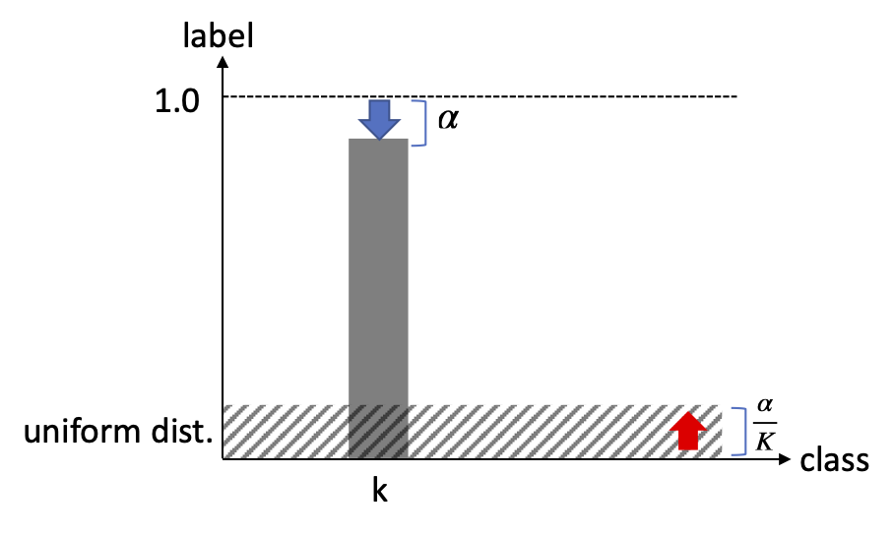
Method: Apply Label Smoothing
By applying label smoothing to augmented data, we can introduce such uncertainty
Rethinking the Inception Architecture for Computer Vision
Szegedy et al., CVPR 2016
Image from https://blog.si-analytics.ai/21
Notes:
To convert the hard label of original data to soft label, we applied the label smoothing technique.
Label smoothing is originally a regularization mechanism which replaces the ground-truth label to mixture of original label and uniform distribution across every label class.
Through applying label smoothing to the label value of augmented data, we can introduce the uncertainty to such perturbed data.
This simple and straightforward approach is the key idea of our proposed method, softEDA.

Slide 12
Method: Overall flow
Dramas like this make it human.
Positive 100% / Negative 0%
Traditional EDA
Assign Positive 100% / Negative 0%
EDA Operation
Synonym Replacement
Random Insertion
Random Swap
Random Deletion
Dramas human this make it like.
Applying label smoothing
softEDA
Assign Positive 90% / Negative 10%
Notes:
Now, we introduce the overall flow of our softEDA method.
softEDA first performs one of sub-operations suggested by original EDA and get augmented sentence.
But, different from previous EDA, which assigns same hard label to augmented data, softEDA takes one more step.
By applying label smoothing and assign soft label to augmented data, we can insert some uncertainty to the label of this perturbed sentence.
Through this simple modification, softEDA keep the benefits of rule-based methods while improving its effectiveness.

Slide 13
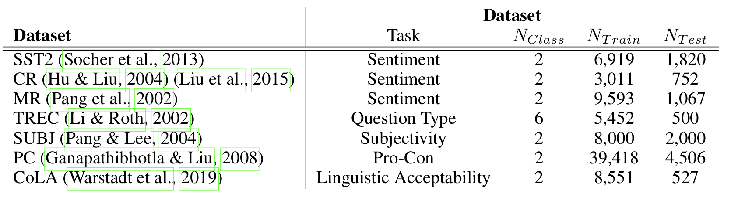
Experiment: Datasets
Evaluated on Seven different
text classification dataset
Notes:
Okay, now we will talk about the experiment to validate our idea and proposed method.
We performed the experiment upon seven different text classification tasks, which is the most fundamental natural language processing task.
These datasets include various domain such as sentiment, subjectivity, type of question, or linguistic acceptability.

Slide 14
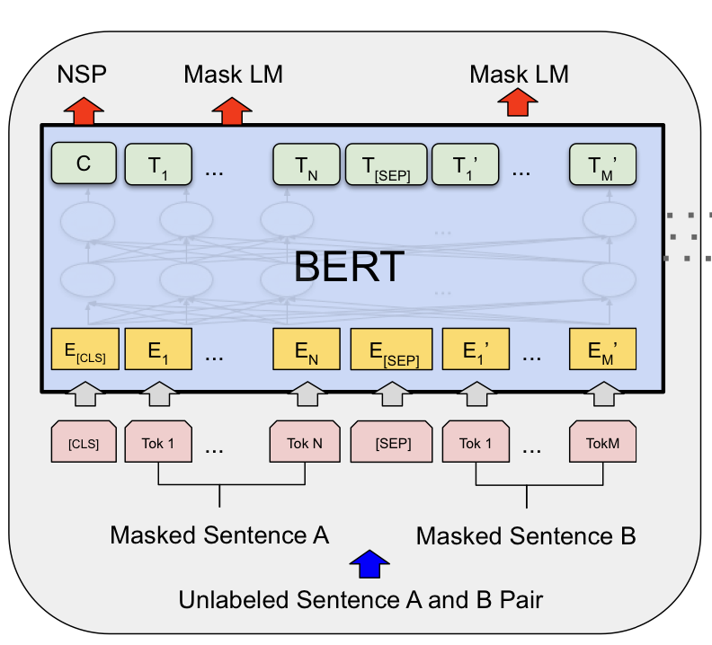
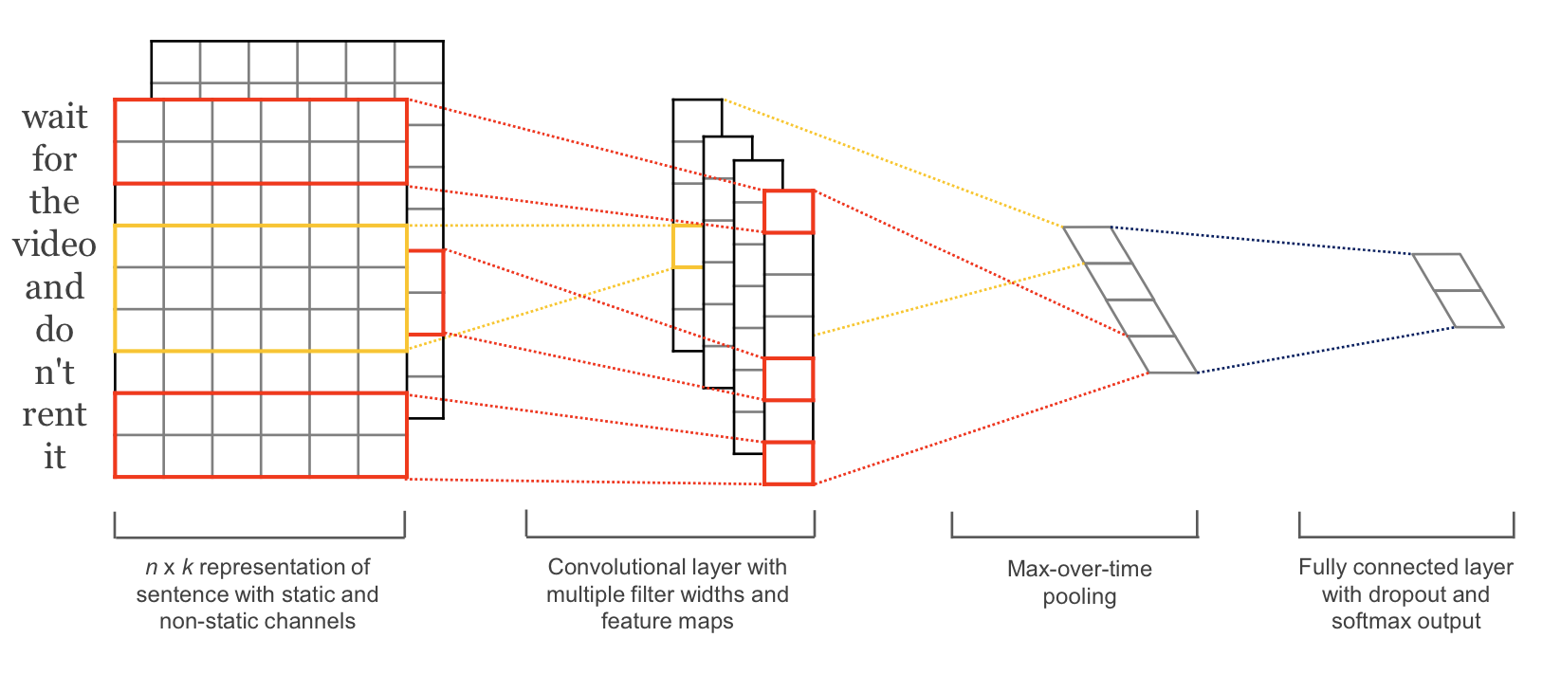
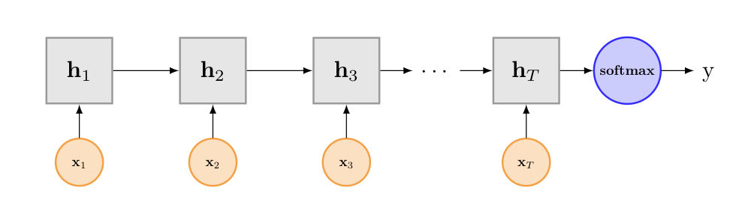
Experiment: Backbone Models
Three different text classification model
CNN-based Model
LSTM-based Model
BERT-based Model
Notes:
And we evaluated the performance through three different backbone, CNN, LSTM, and BERT model.

Slide 15
Experiment: Baseline Methods
EDA Augmentation
AEDA Augmentation
Notes:
Finally, to compare our proposed method with previous ones, we also trained and tested the model by using original EDA and AEDA methods.

Slide 16
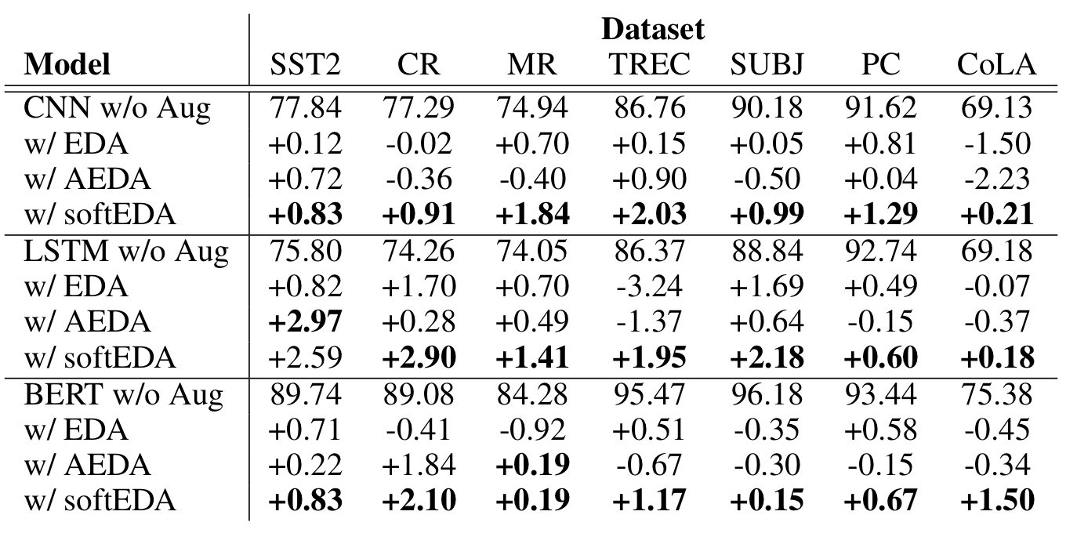
Experiment: Results
Notes:
Our experimental shows that our proposed softEDA. significantly improves the performance of the model.
Even when other methods were not successful and made performance drop, softEDA was able to enhance the model.
Through this experiment, we could find our approach is a useful and effective data augmentation method.

Slide 17
Conclusion
Improving simple augmentation methods
while maintaining its simplicity!
Notes:
In conclusion, our research has shown that rule-based text data augmentation methods can be refined by applying soft labels to augmented data.
By using this straightforward approach, we found it is possible to further improve existing methods while maintaining its core strength of simplicity.

Slide 18
Intro: Data Augmentation
Thank you for listening!
Notes:
Thank you for listening the presentation, and please feel free to ask any questions!

Slide 19
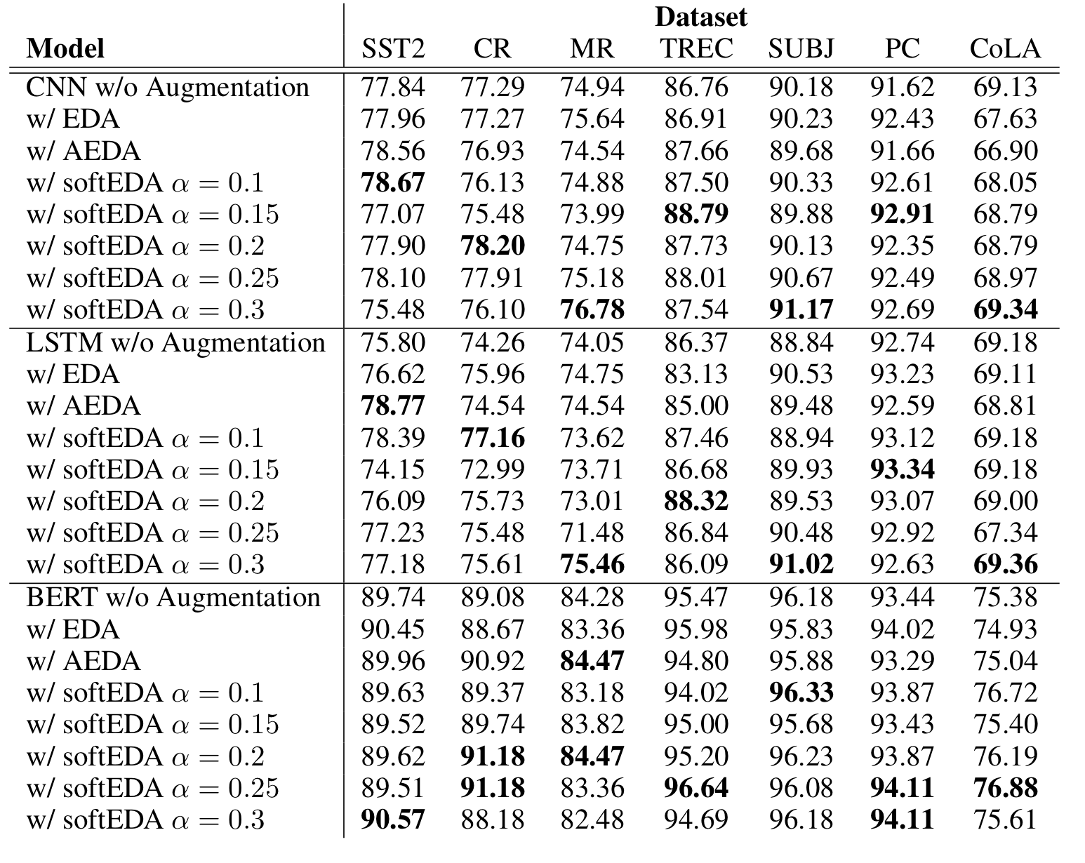
Appendix: Smoothing Factor
Heuristic search of smoothing factor
Notes:
We conducted heuristic search of smoothing factor.
future work may investigate best smoothing factor for each setting.

Slide 20
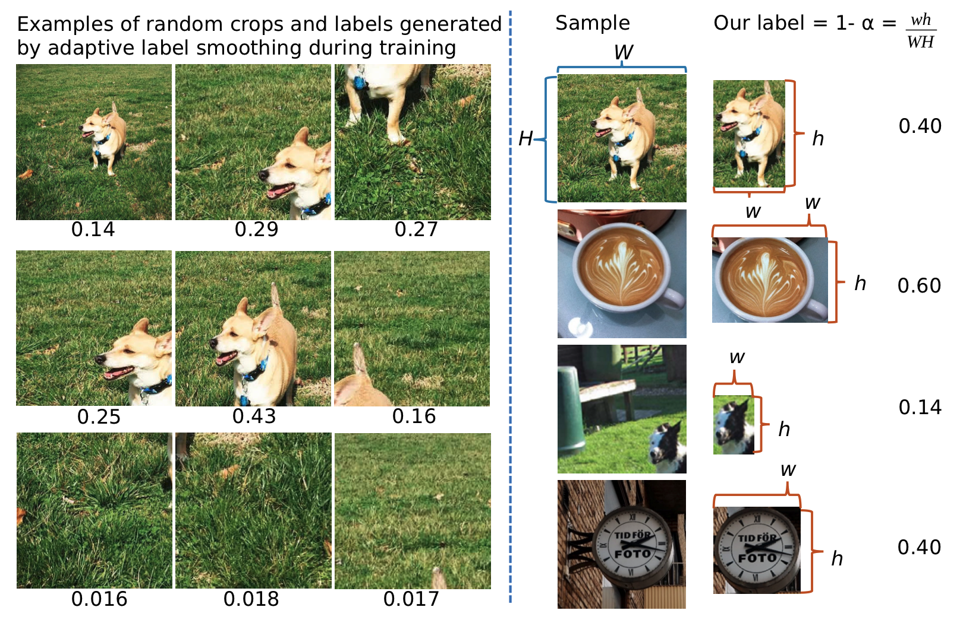
Appendix: Similar Work in Vision Field
Applying adaptive smoothing factor after cropping
One Size Doesn’t Fit All: Adaptive Label Smoothing
Krothapalli and Abbott, arXiv 2020

